Slide 1



Data Bootcamp Final Project
Project title:
Analysis of Attired bank customers
By Cheraine Powell

Slide 2
About Me
I am 28-year-old, Black female from Birmingham, aspiring to break into the technology sector as a Project Manager.
As a people focused manager with a background in housing and hospitality, both are very demanding and people-centred industries
I have managed multiple teams whilst delivering business improvement projects in a high profile restaurant in Birmingham.
As a mother to 5 girls, I have become well versed in organisational, time management and conflict resolution skills.

Slide 3
Why did you choose to learn Data Analytics, and what role would you like to work in following what you've learned?
Embarking on the Black disruptor Bootcamp has been one of the best self-improvement journeys I have embarked on.
Data analytics is a skill that is widely sought after in every sector, as data never lies.
When I came across the course advertised by a member of my church, I knew I would be closing the door on an amazing opportunity if I did not enrol.
I have not regretted once embarking on this journey.

Slide 4
About your project
I chose to analysis data from a credit card company who wanted to investigate the demographic and usage of the customers that had chosen to leave them. Hence the term ‘ attired bank customer ’.

Slide 5
How did you apply what you have learnt in the Bootcamp?
In my analysis, I used a wide range of skills we have learned. Such as:
Advanced Excel Skills- To clean the data i.e. VLOOKUP
SQL – To further analyse the data, using CASE WHEN, GROUP BY and ORDER BY
Power BI – To create a dashboard in order to show the story of the data in an informative yet appealing manner.

Slide 6
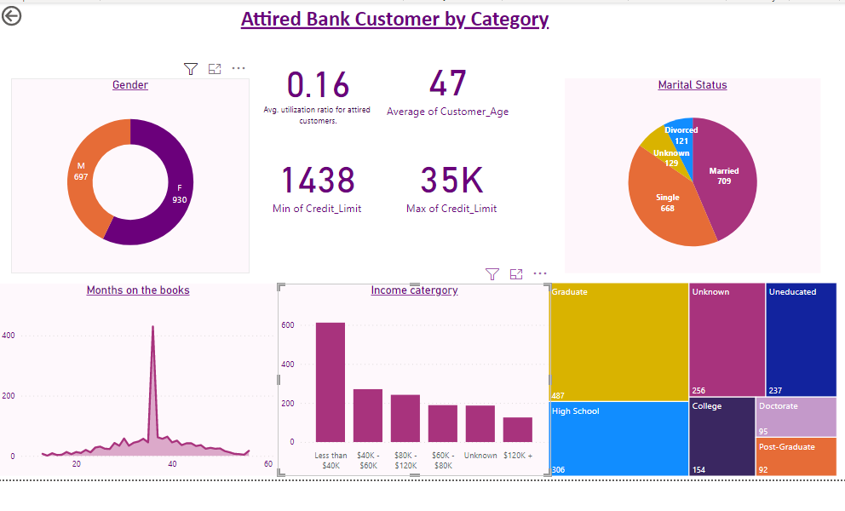

Slide 7
Top 3 Things you have learnt on the bootcamp
Educationally – The importance of analysis tools and how to use them.
Personally - My learning style, that I prefer to practise in real life scenarios.
Career Wise – The vast roles that analysts and project manager play in the development of business’.

